Slide 1
IBM InfoSphere Information Server
Lesson 6: Parallel Processing

Slide 2
Lesson Objectives
After completing this unit, you should be able to:
Describe parallel processing architecture
Describe pipeline parallelism
Describe partition parallelism
List and describe partitioning and collecting algorithms
Describe configuration files
Describe the parallel job compilation process
Explain OSH
Explain the Score

Slide 3
IBM InfoSphere Information Server
6.1 : Datastage parallelism and types

Slide 4
Key Parallel Job Concepts
Parallel processing:
Executing the job on multiple CPUs
Scalable processing:
Add more resources (CPUs and disks) to increase system performance
• Example system: 6 CPUs (processing nodes) and disks
• Scale up by adding more CPUs
• Add CPUs as individual nodes or to an SMP system
1
2
3
4
5
6
Parallel processing is the key to building jobs that are highly scalable. The parallel engine uses the processing node concept. A processing node is a CPU or an SMP, or a board on an MPP.
Notes:
Parallel jobs brings the power of parallel processing to your data extraction and transformation applications.

Slide 5
DataStage parallelism
There are two basic types of parallel processing; pipeline and partitioning. InfoSphere DataStage allows you to use both of these methods
Pipeline parallelism.:- If you ran the example job on a system with at least three processors, the stage reading would start on one processor and start filling a pipeline with the data it had read.
The transformer stage would start running on another processor as soon as there was data in the pipeline, process it and start filling another pipeline.

Slide 6
DataStage parallelism
The stage writing the transformed data to the target database would similarly start writing as soon as there was data available. Thus all three stages are operating simultaneously.
If you were running sequentially, there would only be one instance of each stage. If you were running in parallel, there would be as many instances as you had partitions

Slide 7
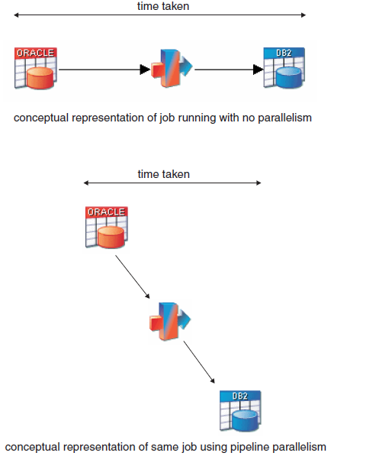
Pipeline Parallelism

Slide 8
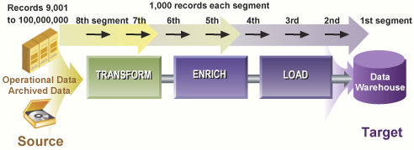
Pipeline Parallelism
Transform, clean, load processes execute simultaneously
Like a conveyor belt moving rows from process to process
Start downstream process while upstream process is running
Advantages:
Reduces disk usage for staging areas
Keeps processors busy
Still has limits on scalability

Slide 9
Partition Parallelism
Divide the incoming stream of data into subsets to be separately processed by an operation
Subsets are called partitions (nodes)
Each partition of data is processed by the same operation
E.g., if operation is Filter, each partition will be filtered inexactly the same way
Facilitates near-linear scalability
8 times faster on 8 processors
24 times faster on 24 processors
This assumes the data is evenly distributed
Partitioning breaks a dataset into smaller sets. This is a key to scalability. However, the data needs to be evenly distributed across the partitions; otherwise, the benefits of partitioning are reduced. It is important to note that what is done to each partition of data is the same. How the data is processed or transformed is the same.

Slide 10
Three-Node Partitioning
Node 1
Here the data is partitioned into three partitions
The operation is performed on each partition of data separately and in parallel
If the data is evenly distributed, the data will be processed three times faster
Subset 1
Operation
Data
Subset 2
Operation
Node 2
Subset 3
Operation
Node 3

Slide 11
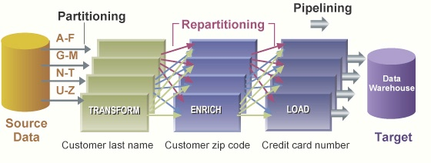
Parallel Jobs Combine Partitioning and Pipelining
Within parallel jobs pipelining, partitioning, and repartitioning are automatic
Job developer only identifies:
Sequential vs. parallel mode (by stage)
Default for most stages is parallel mode
Method of data partitioning
The method to use to distribute the data into the available nodes
Method of data collecting
The method to use to collect the data from the nodes into a single node
Configuration file
Specifies the nodes and resources
Notes:
By combining both pipelining and partitioning DataStage creates jobs with higher volume through put.
The configuration file drives the parallelism by specifying the number of partitions

Slide 12




Job Design v. Execution
User assembles the flow using DataStage Designer
Much of the parallel processing paradigm is hidden from the programmer. The programmer simply designates the process flow, as shown in the upper portion of this diagram.
The parallel engine, using the definitions in the configuration file, will actually execute processes that are partitioned and parallelized, as illustrated in the bottom portion.
… at runtime, this job runs in parallel for any configuration
(1 node, 4 nodes, N nodes)
No need to modify or recompile the job design!

Slide 13
IBM InfoSphere Information Server
6.2 : Configuration File

Slide 14
Configuration File
Configuration file separates configuration (hardware / software) from job design
Specified per job at runtime by $APT_CONFIG_FILE
Change hardware and resources without changing job design
Defines nodes with their resources (need not match physical CPUs)
Dataset, Scratch, Buffer disk (file systems)
Optional resources (Database, SAS, etc.)
Advanced resource optimizations
“Pools” (named subsets of nodes)
Multiple configuration files can be used different occasions of job execution
Optimizes overall throughput and matches job characteristics to overall hardware resources
Allows runtime constraints on resource usage on a per job basis
Notes:
DataStage jobs can point to different configuration files by using job parameters. Thus, a job can utilize different hardware architectures without being recompiled. It can pay to have a 4-node configuration file running on a 2 processor box, for example, if the job is “resource bound.” We can spread disk I/O among more controllers.

Slide 15
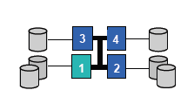
Example Configuration File
{
node " n1 " {
fastname " s1 “
pool " " " n 1" " s 1" "app2 " " sor t“
resource disk " /orch / n1 / d1 " { }
resource disk " / orch / n1 / d2 " { “ bigdata “ }
resource scratchdisk "/ temp " {" s or t "}
}
node " n2" {
fastname " s2 “
pool " " " n 2" " s 2" "app1 "
resource disk " /orch / n2 / d1 " { }
resource disk " / orch / n2 / d2 " { “ bigdata “ }
resource scratchdisk "/ temp " {}
}
node " n3" {
fastname " s3 “
pool " " " n 3" " s 3" "app1 "
resource disk " /orch / n3 / d1 " { }
resource scratchdisk "/ temp " {}
}
node " n4" {
fastname " s4 “
pool " " " n 4" " s 4" "app1 "
resource disk " /orch / n4 / d1 " { }
resource scratchdisk "/ temp " {}
}
}
Key points:
Number of nodes defined.
Resources assigned to each node. Their order is significant .
Advanced resource optimizations and configuration (named pools, database, SAS).

Slide 16
IBM InfoSphere Information Server
6.2 : Partioning and Collecting

Slide 17
Partitioning and Collecting
Partitioning breaks incoming rows into multiple streams of rows (one for each node)
Each partition of rows is processed separately by the stage/operator
Collecting returns partitioned data back to a single stream
Partitioning / Collecting is specified on stage input links

Slide 18
Partitioning / Collecting Algorithms
Partitioning algorithms include:
Round robin
Random
Hash: Determine partition based on key value
Requires key specification
Modulus
Entire: Send all rows down all partitions
Same: Preserve the same partitioning
Auto: Let DataStage choose the algorithm

Slide 19
Partitioning / Collecting Algorithms
Collecting algorithms include:
Round robin
Auto
Collect first available record
Sort Merge
Read in by key
Presumes data is sorted by the key in each partition
Builds a single sorted stream based on the key
Ordered
Read all records from first partition, then second, …

Slide 20
Keyless V. Keyed Partitioning Algorithms
Keyless: Rows are distributed independently of data values
Round Robin
Random
Entire
Same
Keyed: Rows are distributed based on values in the specified key
Hash: Partition based on key
Example: Key is State. All “CA” rows go into the same partition; all “MA” rows go in the same partition. Two rows of the same state never go into different partitions
Modulus: Partition based on modulus of key divided by the number of partitions. Key is a numeric type.
Example: Key is Order Number (numeric type). Rows with the same order number will all go into the same partition.
DB2: Matches DB2 EEE partitioning

Slide 21
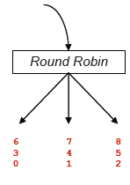
Round Robin and Random Partitioning
Keyless partitioning methods
Rows are evenly distributed across partitions
Good for initial import of data if no other partitioning is needed
Useful for redistributing data
Fairly low overhead
Round Robin assigns rows to partitions like dealing cards
Row/Partition assignment will be the same for a given
$APT_CONFIG_FILE
Random has slightly higher overhead, but assigns rows in anon-deterministic fashion between job runs
Keyless
….8 7 6 5 4 3 2 1 0

Slide 22
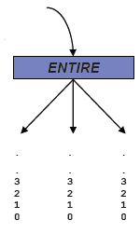
ENTIRE Partitioning
Each partition gets a complete copy of the data
–Useful for distributing lookup and reference data
May have performance impact in MPP / clustered environments
On SMP platforms, Lookup stage (only) uses shared memory instead of duplicating ENTIRE reference data
On MPP platforms, each server uses shared memory for a single local copy
ENTIRE is the default partitioning for Lookup reference links with “Auto” partitioning
On SMP platforms, it is a good practice to set this explicitly on the link(s) Normal Lookup reference
Keyless
….8 7 6 5 4 3 2 1 0

Slide 23
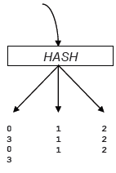
HASH Partitioning
Keyed partitioning method
Rows are distributed according to the values in key columns
Guarantees that rows with same key values go into the same partition
Needed to prevent matching rows from “hiding” in other partitions
E.g. Join, Merge, Remove Duplicates,…
Partition distribution is relatively equal if the data across the source column(s) is evenly key distributed
Keyed
Values of Key column
….0 3 2 1 0 2 3 2 1 1

Slide 24
HASH Partitioning
For certain stages (Remove Duplicates, Join, Merge) to work correctly in parallel, the user must override the default (Auto) to Hash or a variant: Range, Modulus.
Here the numbers are no longer row IDs, but values of key column.
Hash guarantees that all the rows with key value 3 end up in the same partition.
Hash does not guarantee "continuity": here, 3s are bunched with 0s, not with neighboring value 2.
This is an expensive version of Hash, "Range," that guarantees continuity.
Hash does not guarantee load balance.
Make sure key column(s) takes on enough values to distribute data across available partitions.
(“gender” would be a poor choice of key…)

Slide 25
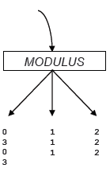
Modulus Partitioning
Keyed partitioning method
Rows are distributed according to the values in one integer key column
Uses modulus
partition = MOD (key_value / #partitions )
Faster than HASH
Guarantees that rows with identical key values go in the same partition
Partition size is relatively equal if the data within the key column is evenly distributed
Keyed
Values of Key column
….0 3 2 1 0 2 3 2 1 1

Slide 26
Auto Partitioning
DataStage inserts partition components as necessary to ensure correct results
Before any stage with “Auto” partitioning
Generally chooses ROUND-ROBIN or SAME
chooses Round Robin when going from sequential to parallel.
chooses Same when going from parallel to parallel.
Inserts HASH on stages that require matched key values (e.g. Join, Merge, Remove Duplicates)
Inserts ENTIRE on Normal (not Sparse) Lookup reference links
NOT always appropriate for MPP/clusters

Slide 27
Auto Partitioning
Since DataStage has limited awareness of your data and business rules, explicitly specify HASH partitioning
when needed when processing requires groups of related records.
DataStage has no visibility into Transformer logic
Hash is required before Sort and Aggregator stages
DataStage sometimes inserts un-needed partitioning
Check the log

Slide 28
Partitioning Requirements for Related Records
Misplaced records
Using Aggregator stage to sum customer sales by customer number
If there are 25 customers, 25 records should be output
But suppose records with the same customer numbers are spread across partitions
This will produce more than 25 groups (records)
Solution: Use hash partitioning algorithm
Partition imbalances
If all the records are going down only one of the nodes, then the job is in effect running sequentially

Slide 29
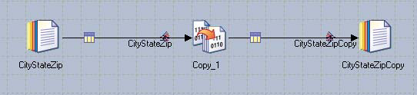
Partitioning / Collecting Link Icons
Partitioning icon
Collecting icon

Slide 30
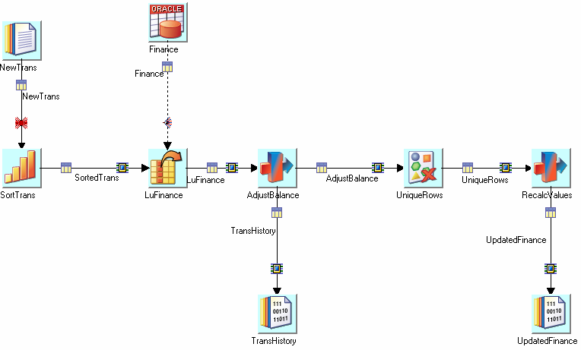
More Partitioning Icons
“fan-out”
Sequential to Parallel
SAME partitioner
Re-partition watch for this !
AUTO partitioner

Slide 31
More Partitioning Icons
Partitioners and collectors have no stage nor icons of their own.
They live on input links of stages running in parallel / sequentially, respectively.
Link markings indicate their presence.
S----------------->S (no Marking)
S----(fan out)--->P (partitioner)
P----(fan in) ---->S (collector)
P----(box)------->P (no reshuffling: partitioner using "SAME" method)
P----(bow tie)--->P (reshuffling: partitioner using another method)

Slide 32
More Partitioning Icons
Collectors = inverse partitioners
recollect rows from partitions into a single input stream to a sequential stage
They are responsible for some surprising behavior:
The default (Auto) is "eager" to output rows and typically causes non-determinism :row order may vary from run to run with identical input.
In the example of repartitioning, the New Trans file is using multiple readers, so the data is being read into multiple partitions. Therefore, a reshuffling occurs at the Sort stage.

Slide 33
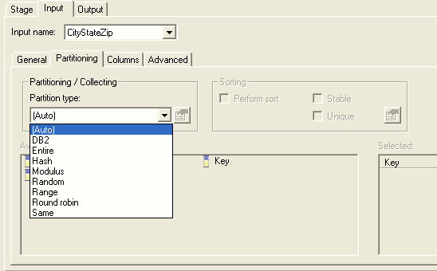
Partitioning Tab
Input tab
Algorithms
Key
specification

Slide 34
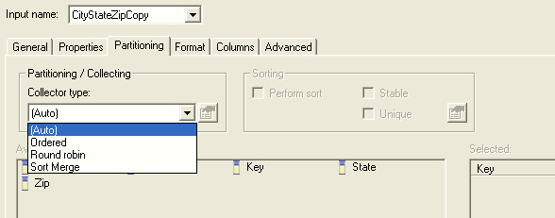
Collecting Specification

Slide 35
Collecting Specification

Slide 36
Q&A
What file defines the degree of parallelism a job runs under?
Name two partitioning algorithms that partition based on key values?
What partitioning algorithm produces the most even distribution of data in the various partitions?

Slide 37
Q&A
Configuration file
Hash, Modulus, DB2
Round robin. Or Entire

